Slide 1
Hotstuff Evaluation
Birju Patel

Slide 2
Project Goal
Evaluate the performance of Hotstuff under attack
Determine if a Hotstuff based BFT system was suitable for the SCADA application

Slide 3
Implementation
I selected a BFT system that implemented the Hotstuff consensus protocol and used a mempool to disseminate transactions across the network
https://github.com/asonnino/hotstuff

Slide 4
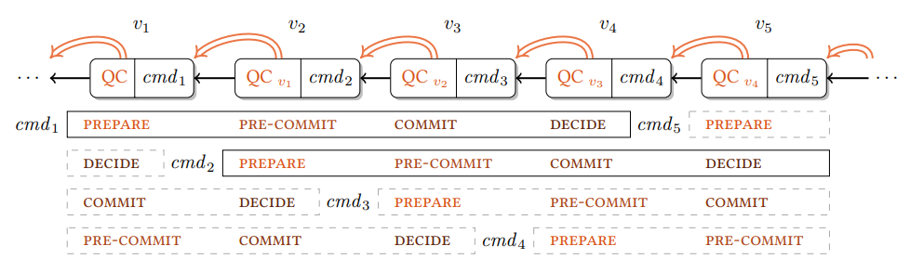
Chained Hotstuff
Three phase commit
Linear view change
View change after each phase
Blockchain based

Slide 5
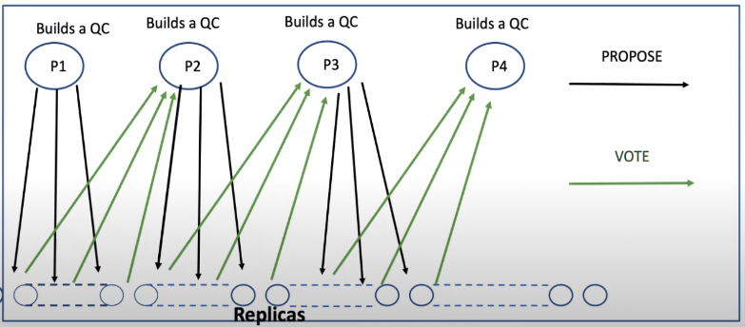
Chained Hotstuff

Slide 6
Mempool
In traditional BFT systems, the transaction that the system is trying to reach consensus on is included in consensus messages
The mempool separates BFT into two layers
  Consensus – Deals with ordering blocks of transactions
  Mempool – Deals with disseminating blocks of transactions across the network

Slide 7
Mempool
The mempool layer takes transactions from clients and packages them in blocks
It then broadcasts those blocks in an unordered manner across the network
A unique hash is created for each block
This hash is then sent to the consensus layer, and the hash is included on consensus messages

Slide 8
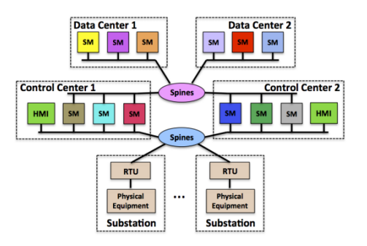
Testing Setup

Slide 9
Testing Setup
aster15
aster16
2.5ms
2.5ms
2.5ms
aster13
aster14
2.5ms

Slide 10
Potential Threats
Crash failures
Network attacks
Byzantine attacks

Slide 11
Test Scenarios
Control - No interference
Kill 1 – Kill and restart a single replica
Site Isolation – Drop all communication to and from a single site, then reconnect the site
Site Isolation + Kill 2 – Isolate a site and simultaneously kill 2 replicas, then reconnect the site and restart the replicas
Delay Attack – A byzantine replica injects 500ms of delay when it becomes leader
Fork Attack – A byzantine replica sends conflicting proposals when it becomes leader

Slide 12
Results

Slide 13
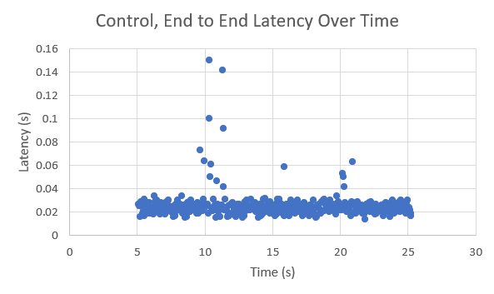
Control

Slide 14
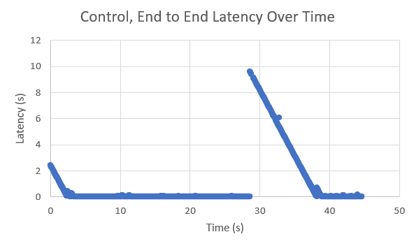
Control, Anomaly

Slide 15
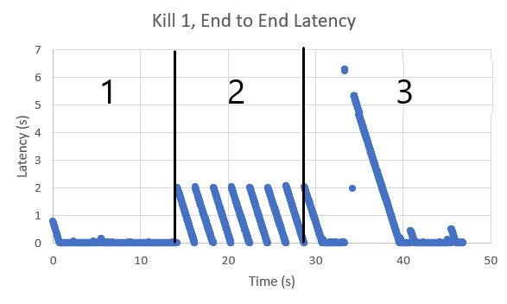
Kill 1

Slide 16
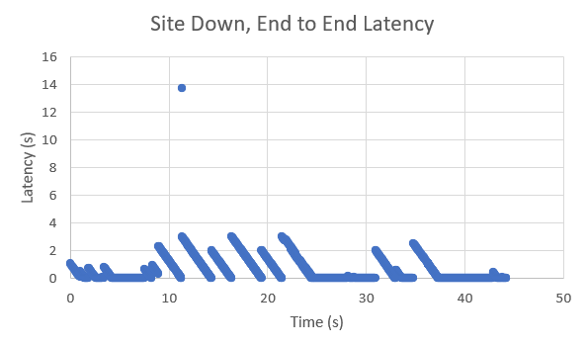
Site Isolation

Slide 17
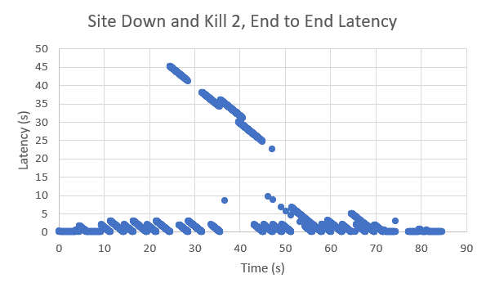
Site Isolation + Kill 2

Slide 18
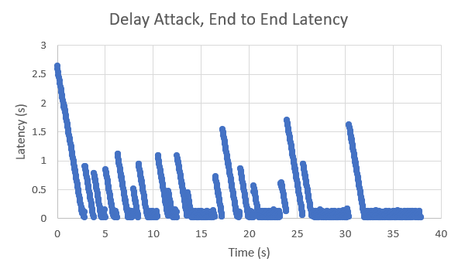
Delay Attack

Slide 19
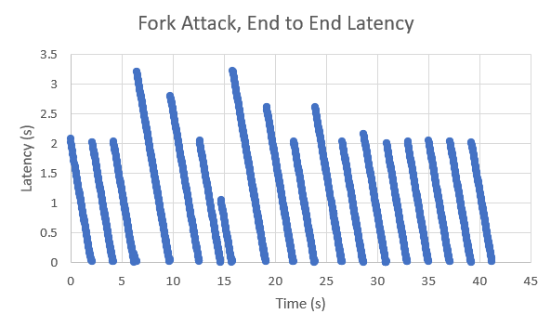
Fork Attack

